Slide 1

IT Essentials (CompTIA A+) Ch. 24
Portable Computing

Slide 2
Overview
In this chapter, you will learn how to:
Describe the many types of portable computing devices available
Explain ways to expand portable computers
Manage and maintain portable computers
Upgrade and repair portable computers
Troubleshoot portable computers
Notes:
2

Slide 3
Portable Computing Devices
All portables share some features, such as LCD screens and battery power.
They come in an amazing variety of shapes, sizes, and intended uses.
They have varying levels of sound and video quality, screen size, and features.
The traditional clamshell notebook computer has built-in monitor, keyboard, and input device.
Also called a portable or a laptop

Slide 4
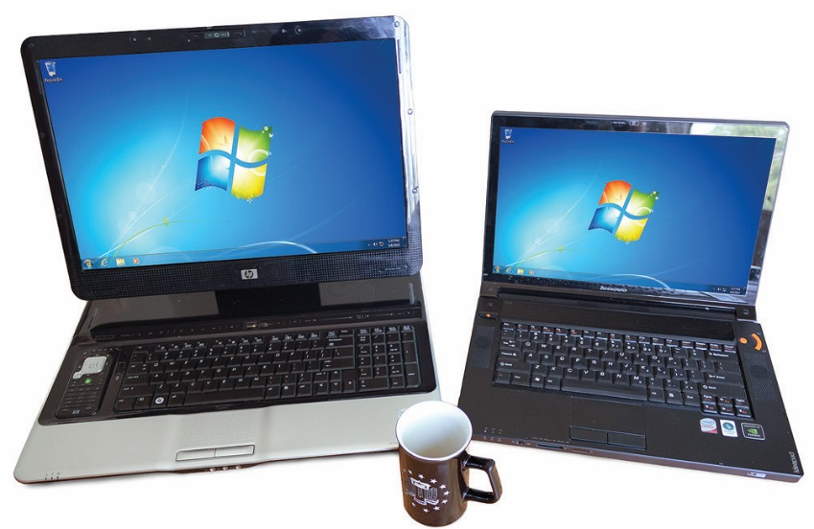
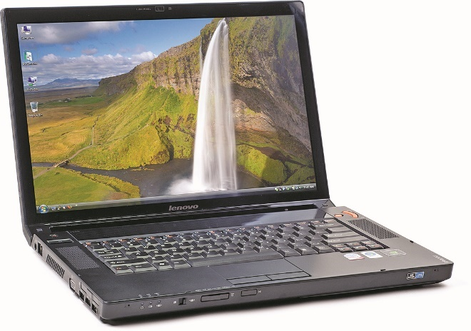
Portable Computing Devices
Figure 24.1 A notebook computer
Figure 24.2 Desktop replacement (left) next to a standard portable computer (right)

Slide 5
Taxonomy
Desktop replacement features:
Massive screen
Full-size keyboard
Optical drive
Plenty of hard drive space
A desktop replacement is designed for power first, portability second.
Can work well on the road and in the office

Slide 6
Taxonomy
Gaming laptops
Built to replace desktop gaming machines
Tend to have flashy designs
Loaded with top-end processors, graphics cards, RAM, SSDs, and large, high-quality displays
Subnotebooks
Smaller and lighter than standard portable computers

Slide 7
Taxonomy
Netbooks
Small screen, low power, low cost, and long battery life
Mostly run on lightweight operating systems
Live on in other newer portable categories
The term netbook has fallen out of vogue.

Slide 8
Taxonomy
Chromebooks
Successors to netbooks
Portable computers running Google’s Linux-based Chrome OS
Light, inexpensive, with modest computing power

Slide 9
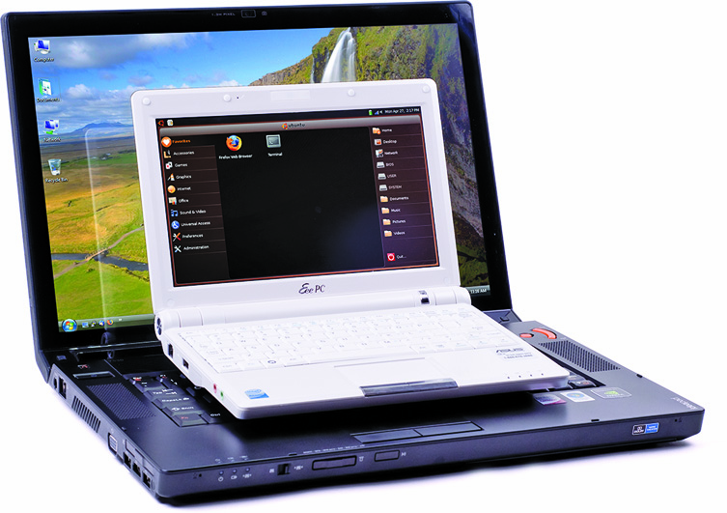
Taxonomy
Figure 24.3 ASUS Eee PC sitting on a normal laptop

Slide 10
Taxonomy
Ultrabooks
These portable computers are thin, light, and powerful.
Intel has defined maximum dimensions (20-23mm thick) and minimum battery life (6 hours of HD video playback).
2-in-1s
Touchscreen computer combining laptop and tablet features
Many different form factors
Notes:
You may run into a recent term, laplet, which describes a hybrid device with a full desktop OS and laptop-level specs—all in a tablet form factor.

Slide 11
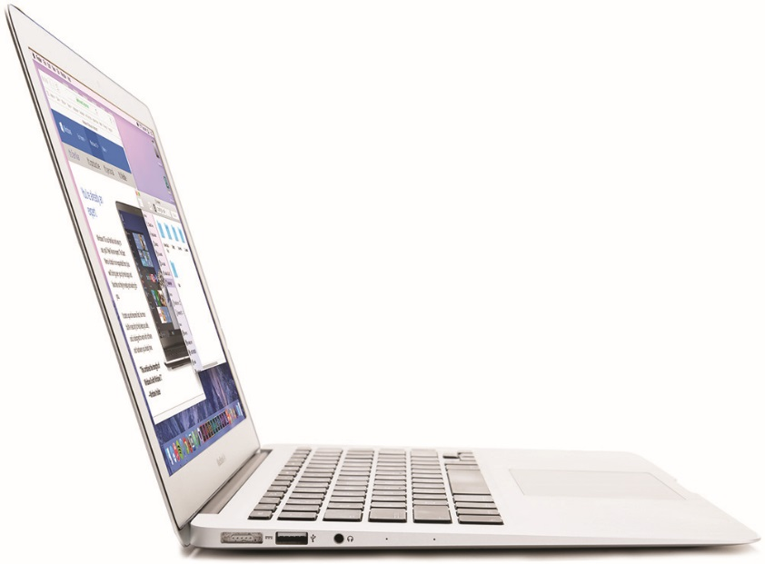
Taxonomy
Figure 24.4 MacBook Air

Slide 12
Taxonomy
Tablet PCs
Screen doubles as an input device.
Most come with special pen called stylus used to write on the screen
There are two main form factors.
Convertibles have a keyboard that folds out of the way.
Slates do not have a keyboard.
Tablet PCs are more effective with applications designed to be used with a stylus instead of a keyboard.
Notes:
Tablet PC is a Microsoft term (though you’ll rarely catch Microsoft using the term itself anymore) and is not the equivalent of a tablet such as the Apple iPad or Samsung Galaxy Tab. The latter devices derive from the mobile phone market.

Slide 13
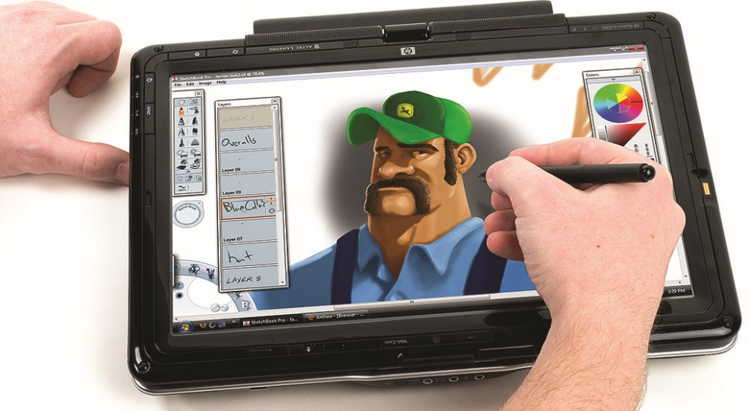
Taxonomy
Figure 24.5 A Tablet PC

Slide 14
Taxonomy
Convertible
A convertible is a laptop that uses some mechanism to convert into something else like a tablet.
Some have removable screens.
Others feature hinge-based mechanisms.
Hybrid laptop/tablet
A device with a tablet form factor that is designed to integrate with a detachable keyboard
Notes:
.

Slide 15
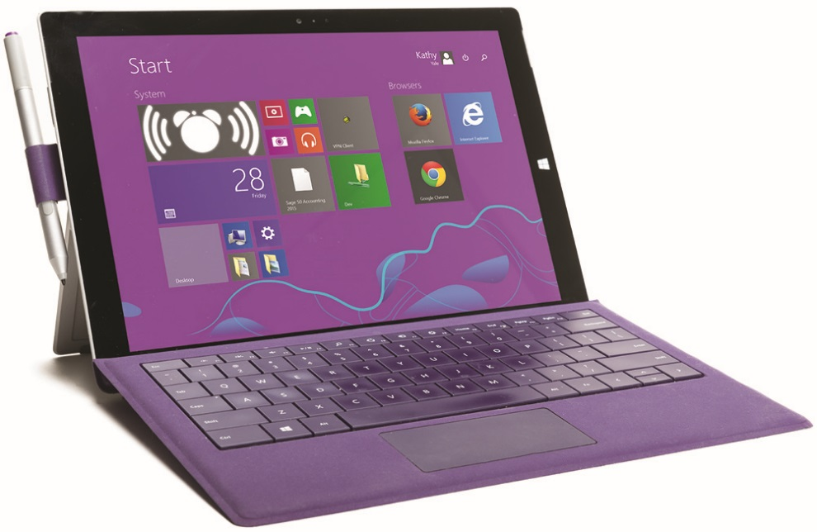
Taxonomy
Figure 24.6 Microsoft Surface Pro 3 with its keyboard cover

Slide 16
Input Devices
Portable computers come with a variety of input devices.
Most have a fully functional keyboard and a device to control the mouse pointer.
Keyboards are different from those of desktop computers due to a smaller form factor.
Same QWERTY format, but keys are smaller and non-alphabet character keys positioned differently.
Almost all use Function (FN) key to allow keys to perform an extra duty.

Slide 17
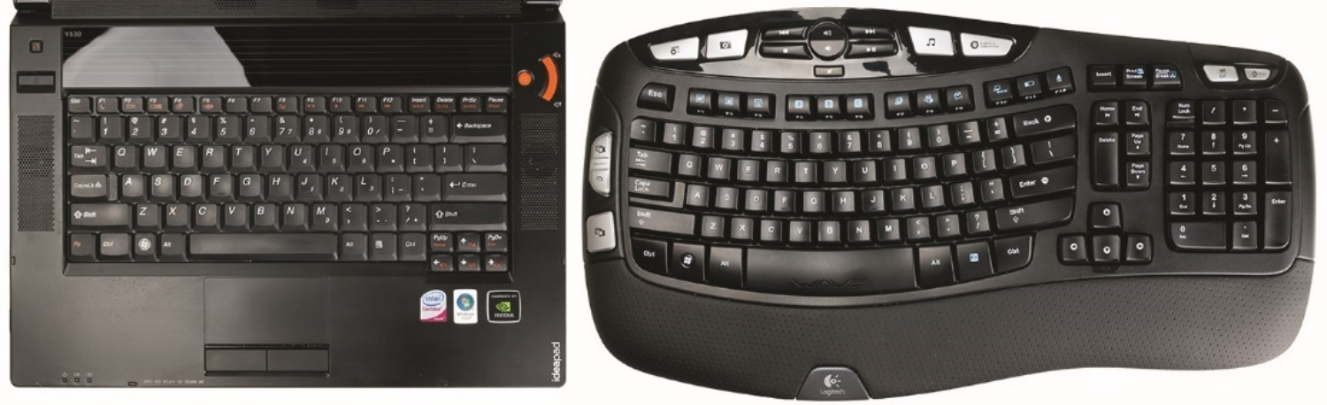
Input Devices
Figure 24.7 Keyboard comparison

Slide 18
Input Devices
Pointing devices
Most portables today have USB ports.
Enables use of all types of pointing devices
Early portables used trackballs, often plugged in like a mouse and clipped to the side of the case.
Some used IBM’s TrackPoint device, a joystick the size of a pencil eraser, situated in the center of the keyboard.
Touchpad is the most common laptop pointing device today.

Slide 19
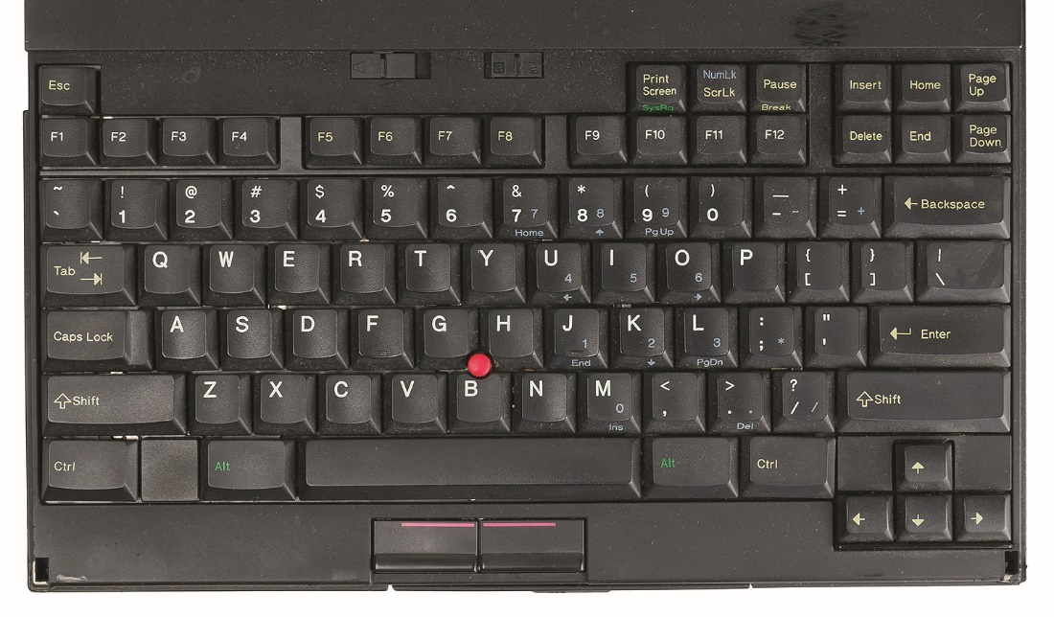
Input Devices
Figure 24.8 IBM TrackPoint

Slide 20
Input Devices
Multitouch touchpads allow gestures (actions with multiple fingers)
Touchscreens are found on traditional laptops or on devices intended to be both tablet and laptop.
Notes:
In the past, it was common to accidentally “use” a touchpad with your palm while typing, so you may find some devices with a hardware switch or FN key combination for disabling the touchpad. More recent touchpads are usually capable of detecting and ignoring accidental input like this on their own.

Slide 21
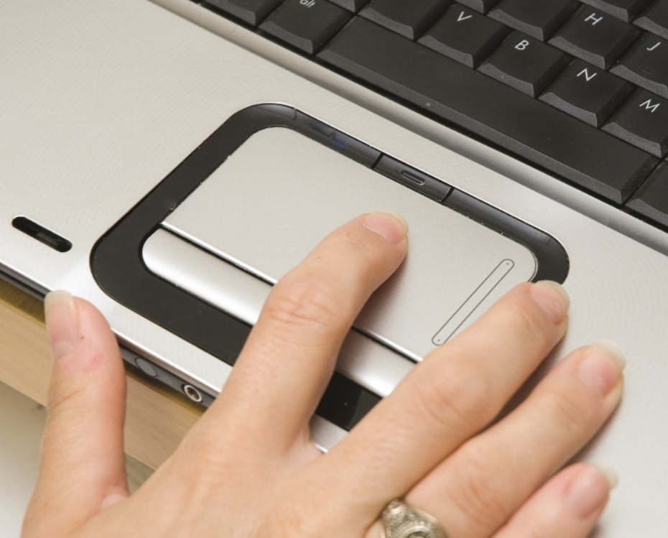
Input Devices
Figure 24.9 Touchpad on a laptop

Slide 22
Input Devices
Webcams and microphones
Most portable devices come equipped with camera and one or more built-in microphones.
A camera on a laptop is called a Webcam.
A microphone can be used in conjunction with a webcam.
On a system with a microphone, searches can be performed verbally in the Chrome browser.
The downside of these input devices becoming ubiquitous is the security risk they pose.

Slide 23
Display Types
The LCD screen is a major contributor to overall laptop cost.
Most range from 10.1 inches to 17.3 inches.
Aspect ratio compares screen width to height.
In the past, 4:3 was standard.
Today’s widescreens are 16:9 or 16:10.
Laptop LCD screen resolutions come in a variety of supported resolutions.
XGA, WXGA, WSXGA, and more
Screen finishes are matte or high-gloss.
Notes:
Laptop LCDs are the same in almost every way as desktop LCDs with a TFT screen, an inverter (if using a CCFL backlight), and a backlight (CCFL or LED). You know all about these screens from Chapter 19, “Display Technologies.” Expect questions about laptop displays, but know that they’re pretty much the same as desktop displays. The only major difference is that the LCD frame contains an antenna, and may contain a camera and microphone.

Slide 24
Display Types
The same LCD/LED technologies found in new desktop monitors are also used in portables.
LED backlighting for LCD panels
Twisted nematic (TN) technology
In-Plane Switching (IPS) panels
Two technologies are NOT used on portables:
Plasma – energy needs too high
Organic light-emitting diode (OLED) – too expensive

Slide 25
Extending Portable Computers
Earlier portable computers lacked the ability to be upgraded.
Many ways to enhance today’s portable computers.
Today’s portable computers include a wide variety of external ports.

Slide 26
Single-Function Ports
All portable computers come with one or more single-function ports.
Ports work the same way on portable computers as they do on desktop models.
Plug in a device to a particular port and, as long as Windows has the proper drivers, you will have a functioning device when you boot.

Slide 27
Single-Function Ports
Audio
Portable computers have a standard 3.5-mm audio-out port.
Some have a similarly sized microphone-in port.
Control the sound (both out and in) through either the appropriate Control Panel applet in Windows, System Preferences in Mac OS X, or switches on the laptop.
Some portables use a combination of the FN key and another key to toggle mute on and off.

Slide 28
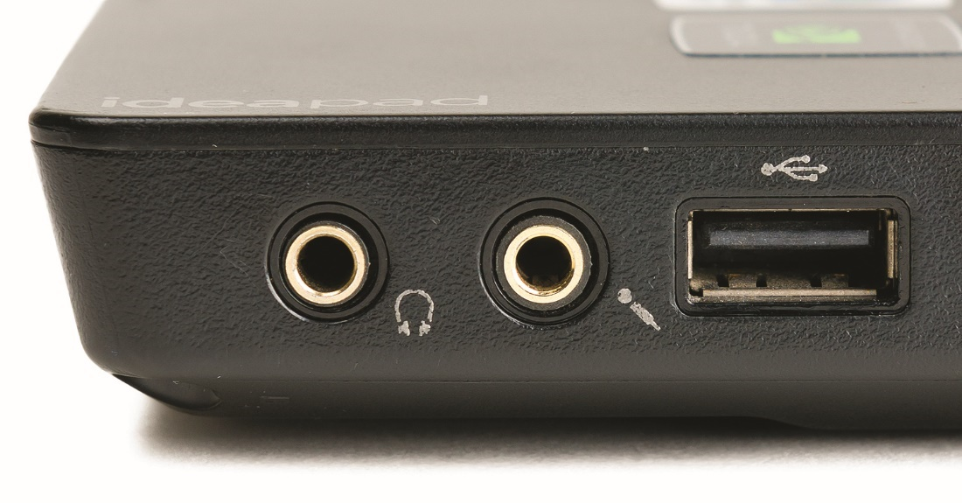
Single-Function Ports
Figure 24.10 Standard audio ports

Slide 29
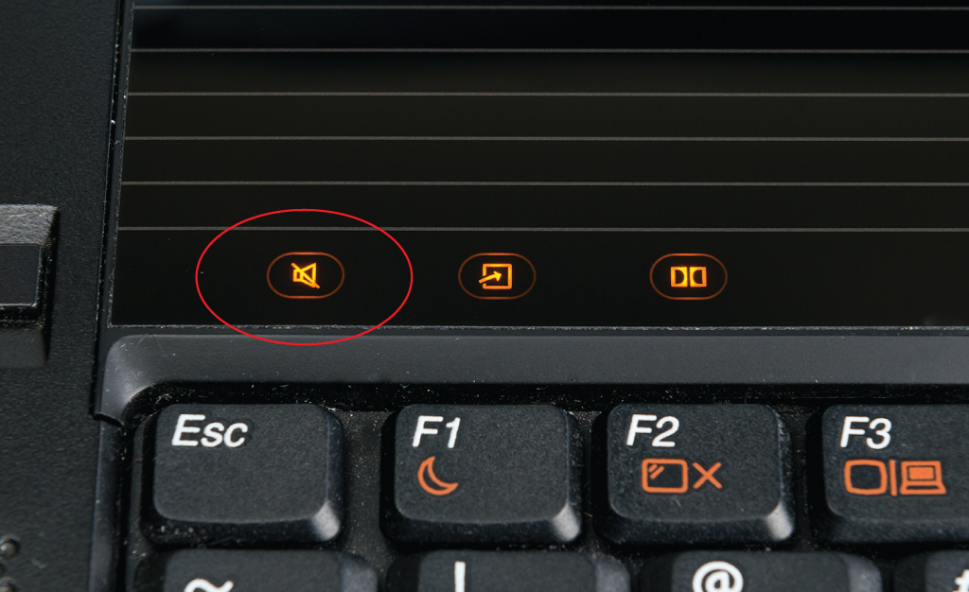
Single-Function Ports
Figure 24.11 The mute button on a laptop

Slide 30
Single-Function Ports
Display
Most laptops support a second monitor via a digital port.
DVI, HDMI, Mini-HDMI, Micro-HDMI, or DisplayPort
Analog VGA on older machines
With a second monitor, you can duplicate or extend desktop across both displays.
Most portables use the FN key plus another key on the keyboard to cycle through display options.
You can control how the external monitor displays through the Display applet in the Control Panel.
Notes:
Although many laptops use the Function key method to cycle the monitor selections, that’s not always the case. You might have to pop into the Display applet or System Preferences to click a checkbox. Just be assured that if the laptop has a video output port, you can cycle through monitor choices!

Slide 31
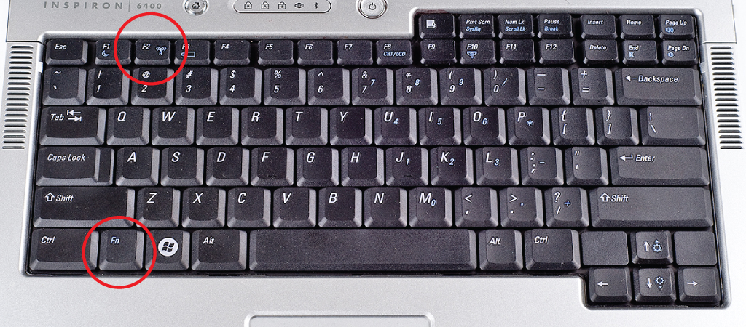
Single-Function Ports
Figure 24.12 Laptop keyboard showing Function (fn) key that
enables you to access additional key options, as on the f2 key

Slide 32
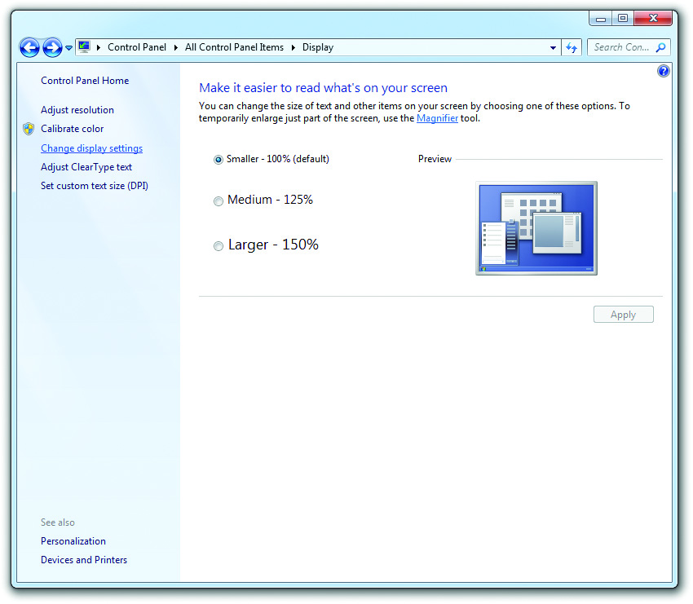
Single-Function Ports
Figure 24.13 Display applet in Windows 7

Slide 33
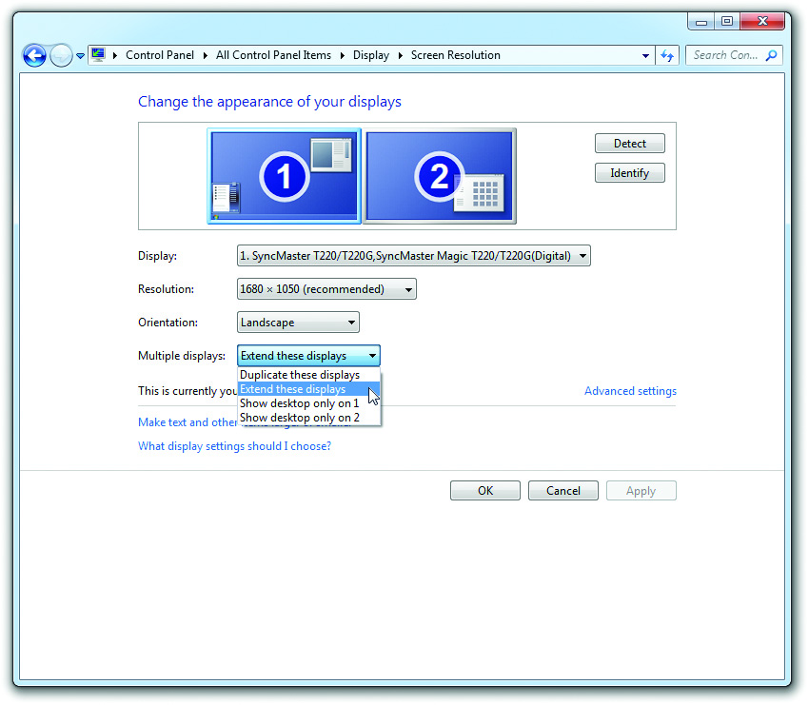
Single-Function Ports
Figure 24.14 Multiple-display options menu in Windows 7

Slide 34
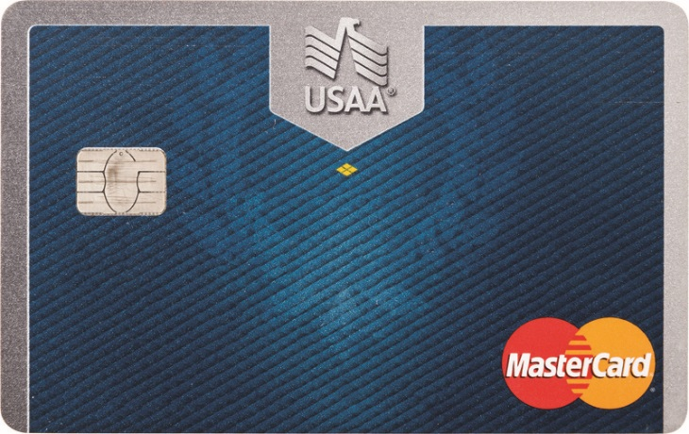
Single-Function Ports
Smart card reader
Can log into a portable device using a smart card
Will be covered in Chapter 28
Figure 24.15 Smart card

Slide 35
Networking Options
Today’s laptops come with 802.11, Bluetooth, or wired Ethernet connections.
Most portables today have Wi-Fi built directly into the chipset.
802.11n or 802.11ac on newer laptops
802.11b or 802.11g on older laptops
Most portables also use Bluetooth.
Enables adding wireless mice, keyboards, and headsets
Notes:
While the newest portables are shipping with 802.11ac, be aware that, especially as portables are getting powerful enough to live longer useful lives, you may see a few previous standards built into devices in the wild.

Slide 36
Networking Options
Hardware switches
Includes a switch to toggle the antenna off or on
For use in areas where emissions aren’t allowed (like a commercial aircraft)
Switch – hard-wired or a toggle of the FN key plus another key
Wired Ethernet
Most laptops have an RJ-45 wired Ethernet connection.
They have link lights and connect via UTP.
Notes:
Hardware switches or special Function key toggles enable you to switch features on and off, such as wireless networking, cellular networking, and Bluetooth. Toggle them off when in a scenario where battery life takes priority over networking.

Slide 37
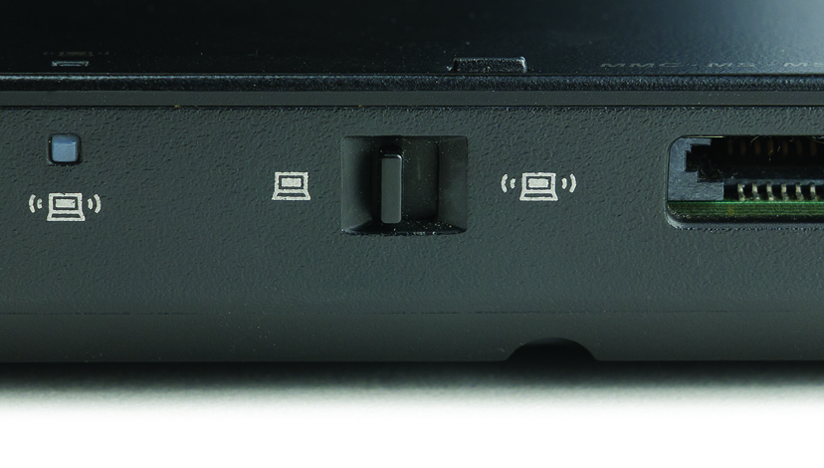
Networking Options
Figure 24.16 Wireless switch

Slide 38
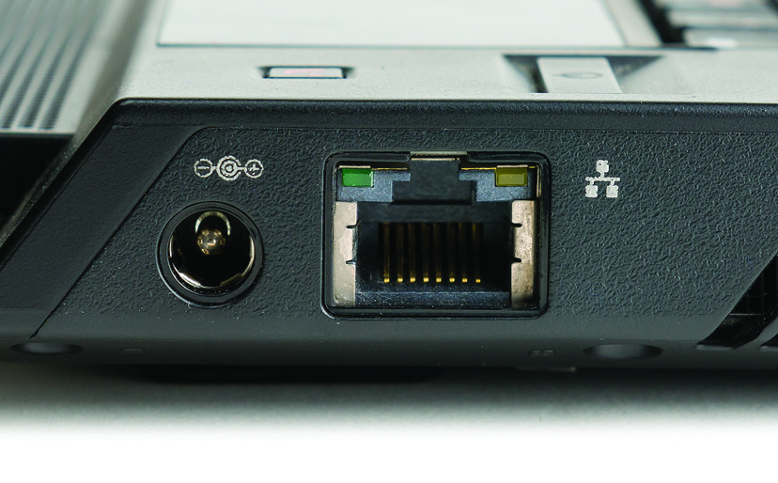
Networking Options
Figure 24.17 Ethernet port on laptop

Slide 39
Portable-Specific Expansion Slots
Expansion slots
Specialized connections for adding features
Once common on portables; now replaced by USB
The last standard was called ExpressCard.
Personal Computer Memory Card International Association (PCMCIA)
Defined standards for expansion cards and slots
Now defunct

Slide 40
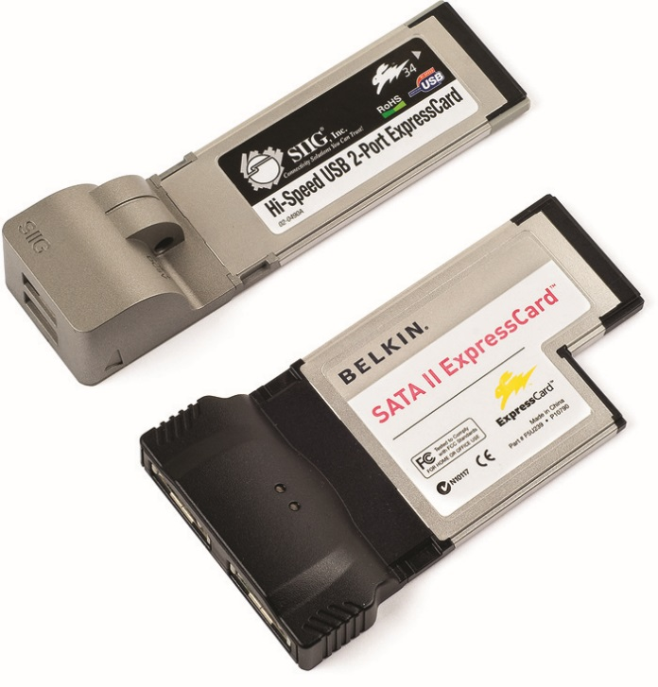
Portable-Specific Expansion Slots
ExpressCard
Comes in 34mm and 55mm widths
Connects to either USB 2.0 bus or PCI Express bus
Figure 24.18 34-mm and 54-mm ExpressCards

Slide 41
Portable-Specific Expansion Slots
Table 24.1 | ExpressCard Speeds
Standard |  | Maximum Theoretical Throughput
ExpressCard using Hi-Speed USB 2.0 bus |  | 480 Mbps
ExpressCard using PCIe bus |  | 2.5 Gbps

Slide 42
Storage Card Slots
Many portable computers offer one or more flash-memory card slots to enable you to add storage.
Enable fast transfer of data from the card to the portable, and vice versa
Standard varieties: SD and microSD

Slide 43
General-Purpose Ports
Legacy ports
PS/2, RS-232 serial, and parallel
Modern ports
USB, Thunderbolt, eSATA, and FireWire
Plug and go – no reboot required
Docking station
Offers legacy and modern single- and multi-function ports
Notes:
43

Slide 44
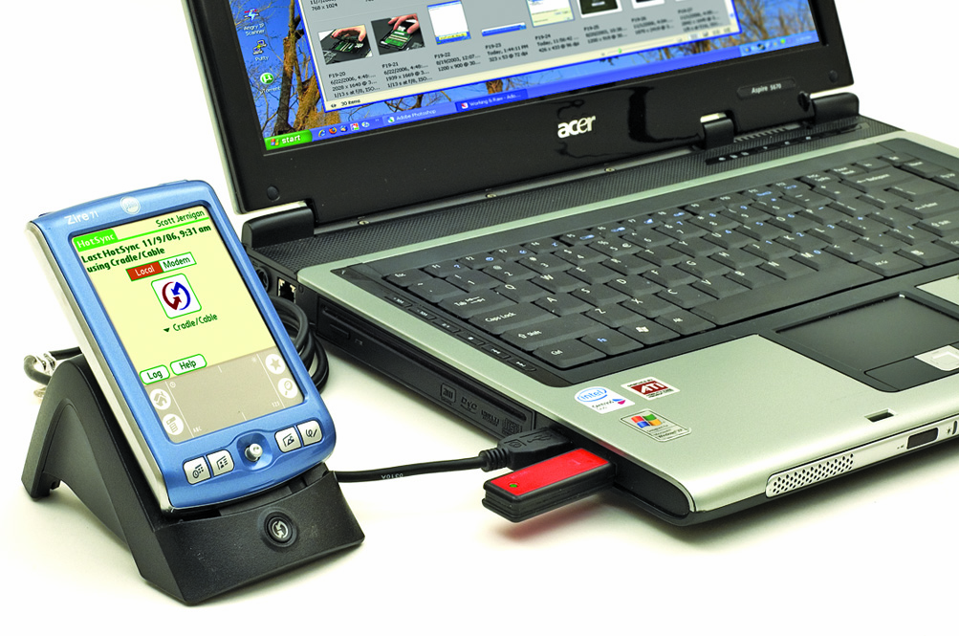
General-Purpose Ports
Figure 24.19 Devices attached to USB on a portable PC
(Whooooa, retro PDA, dude!)

Slide 45
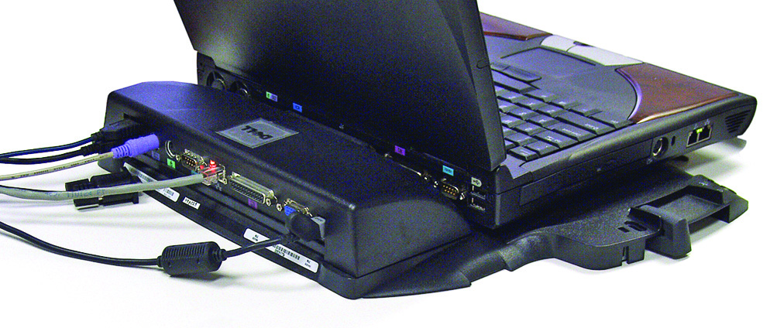
General-Purpose Ports
Figure 24.20 Docking station

Slide 46
General-Purpose Ports
USB adapters
When it comes to drives or connectors that you need only occasionally, these adapters can enable you to use a much more portable device.
Examples of using USB adapters:
Connecting to wired Ethernet
Connecting an optical drive
Updating connectivity support for older devices
Notes:
46

Slide 47
Managing and Maintaining Portable Computers
Most common maintenance work
Taking care of the batteries through proper power management
Keeping machine clean
Avoiding excessive heat
Maintenance that applies to computers
Applies to portables as well

Slide 48
Batteries
Three types of batteries have been most commonly used in portable computers.
Nickel-cadmium (Ni-Cd)
Nickel-metal hydride (Ni-MH)
Lithium-Ion (Li-Ion)
Lithium polymer (LiPo) batteries are a variation of Li-Ion.
Notes:
48

Slide 49
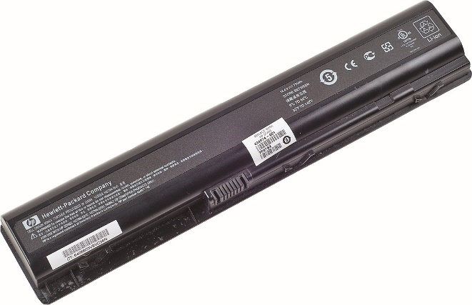
Lithium Ion Batteries
Only type used today
Highest energy for the weight
Longer-lasting than other types
Built-in circuitry to prevent accidental overcharging
Figure 24.21 Li-Ion battery
Notes:
49
Today, only Li-Ion batteries are used, because that battery chemistry provides the highest energy density for the weight and has few problems.

Slide 50
The Care and Feeding of Batteries
Batteries should be stored in a cool place.
But not the freezer!
Keep the battery charged, at least to 70–80 percent.
Never drain a battery all the way down unless required to do so as part of a battery calibration.
Rechargeable batteries have a limited number of charge-discharge cycles before overall battery performance is reduced.
Notes:
50

Slide 51
The Care and Feeding of Batteries
Never handle a ruptured battery.
Battery chemicals are very dangerous and flammable.
Recycle old batteries.
Notes:
51

Slide 52
Power Management
With early laptops, all components drew power continuously.
CPU, RAM, drives, motherboard
Power management involves hardware, BIOS, and OS working together to reduce power use.

Slide 53
Power Management
System Management Mode (SMM)
Enables the CPU to slow down or stop its clock without erasing information
Enables power saving in peripherals
Requires a specialized BIOS and OS
Extensions of power management capabilities
Advanced Power Management (APM) specification introduced in 1992
Advanced Configuration and Power Interface (ACPI) standard introduced in 1996
Notes:
53

Slide 54
Power Management
APM and ACPI require:
SMM-capable CPU
APM-compliant BIOS (so CPU can shut off peripherals)
Devices that will accept being shut off (“Energy Star”)
A system OS that knows how to request the shutdown of a particular device
ACPI goes beyond the APM standard by supporting hot-swappable devices.
Notes:
54
Don’t limit your perception of APM, ACPI, and Energy Star simply to laptops! Virtually all desktop systems also use the power management functions.

Slide 55
APM/ACPI Levels
Full On
No power management—everything running
APM Enabled
CPU and RAM are running at full power.
Unused devices may or may not be shut down.
APM Standby
CPU is stopped (can easily be restarted).
RAM still stores all the programs.
All peripherals are shut down (configuration options stored).
Notes:
55

Slide 56
APM/ACPI Levels
APM Suspend
Everything is shut down or at its lowest power-consumption setting.
In hibernation, critical configuration information is written to the hard drive.
System reinitialized upon wake-up event
Data read from drive to return to APM Enabled
Notes:
56

Slide 57
ACPI Global (G) and Sleeping (S) Power State Specifications
G0 (S0) Working state
G1 Sleeping state mode—further subdivided into four S states:
S1 – CPU stops processing. Power to CPU and memory (RAM) is maintained.
S2 – CPU is powered down.
S3 – Sleep or Standby mode. Power to RAM is still on.
S4 – Hibernation mode. Information in RAM is stored to nonvolatile memory or drive and powered off.
Notes:
57

Slide 58
ACPI Global and Sleeping Power State Specifications
G2 (S5) – Soft power-off mode
Certain devices used to wake a system—such as keyboard, LAN, USB, and other devices—remain on, while most other components are powered to a mechanical off state (G3).
G3 – Mechanical off mode
The system and all components, except the real-time clock (RTC), are completely powered down.
Notes:
58

Slide 59
Configuration of APM/ACPI
Configuration through CMOS settings or operating system
OS settings override CMOS settings.
Windows power plans
Found in Control Panel applet Power Options
Hibernate mode
Takes everything in active memory and stores it on the hard drive before system powers down

Slide 60
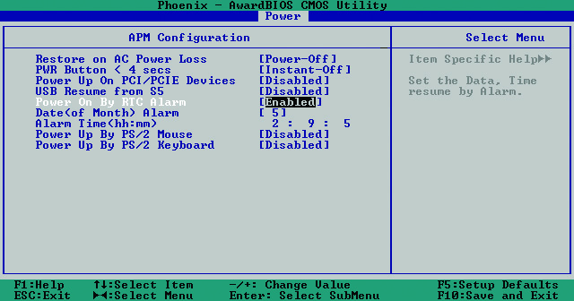
Configuration of APM/ACPI
Figure 24.22 Setting a wake-up event in CMOS

Slide 61
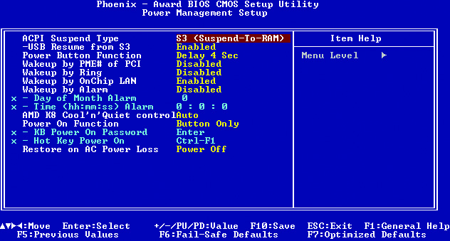
Configuration of APM/ACPI
Figure 24.23 CMOS with ACPI setup option

Slide 62
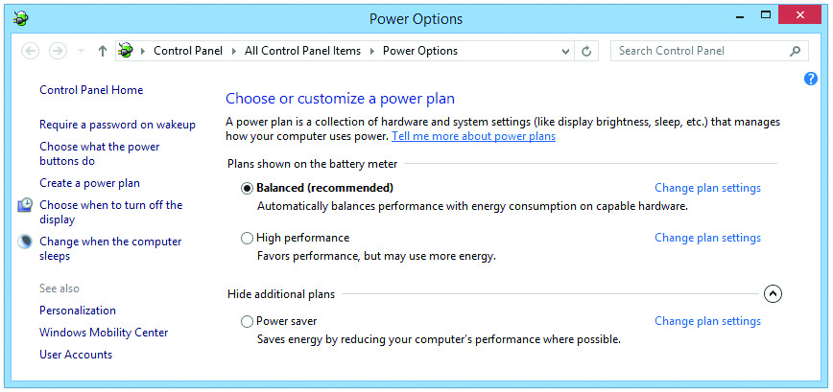
Configuration of APM/ACPI
Figure 24.24 Windows Balanced, High performance, and Power Saver power plan options
Notes:
62

Slide 63
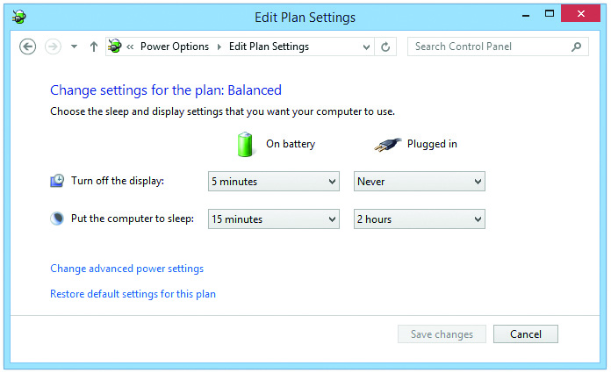
Configuration of APM/ACPI
Figure 24.25 Customizing a laptop power plan in Windows

Slide 64
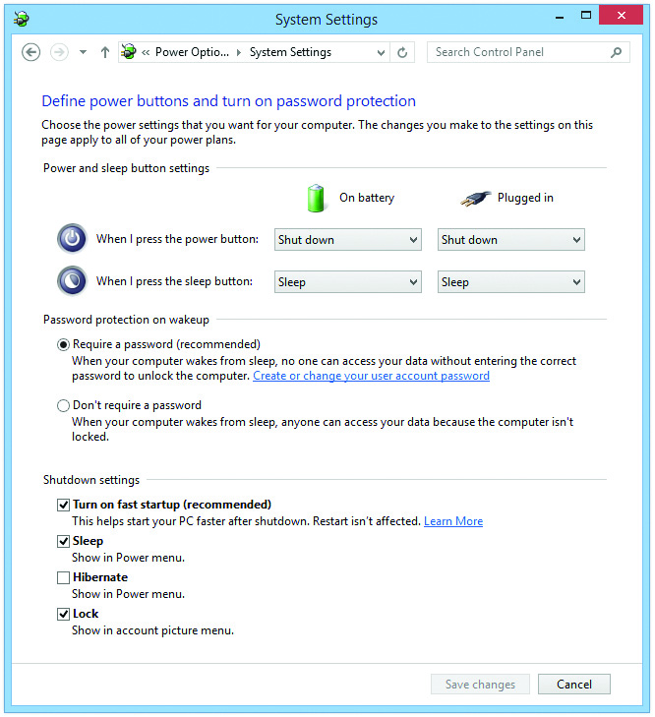
Configuration of APM/ACPI
Figure 24.26 Windows 10 hibernation settings in the Power Options applet

Slide 65
Manual Control over Power Use
Manual options for reducing battery use
Disabling the Wi-Fi antenna or Bluetooth via on/off switch or keyboard combination
Disabling all or most wireless components at once with airplane mode
Disabling LCD backlit keyboard when not in use
Can also reduce backlight output using combination of FN and another key
Planning ahead for times when unplugged – one of the best ways to conserve battery use
Limit use of Wi-Fi and USB by using offline files.

Slide 66
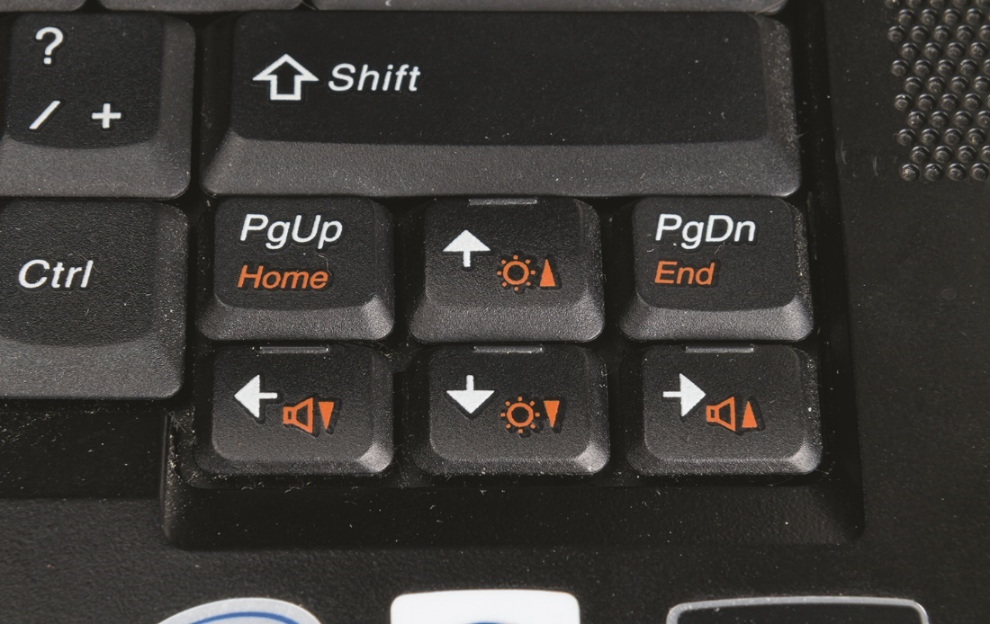
Manual Control over Power Use
Figure 24.27 Keys for adjusting screen brightness

Slide 67
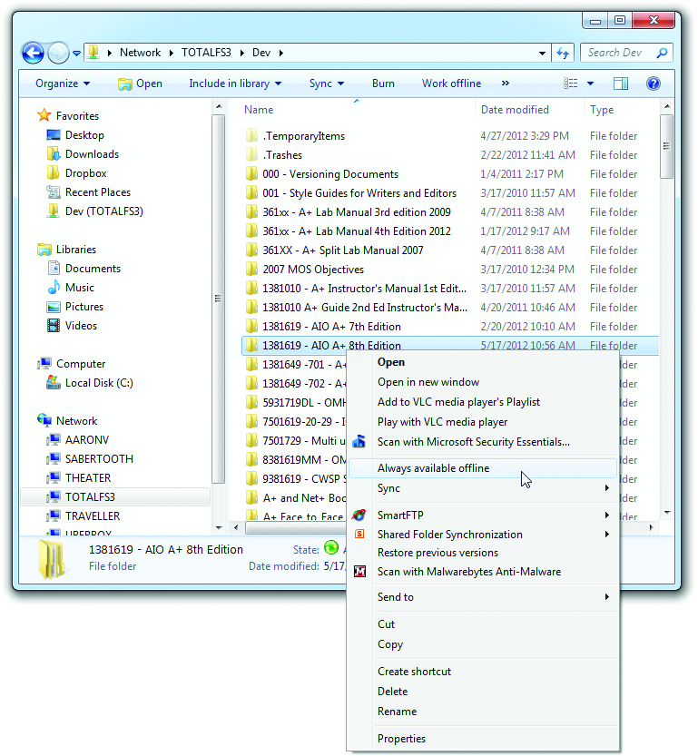
Manual Control over Power Use
Figure 24.28 Setting up offline files

Slide 68
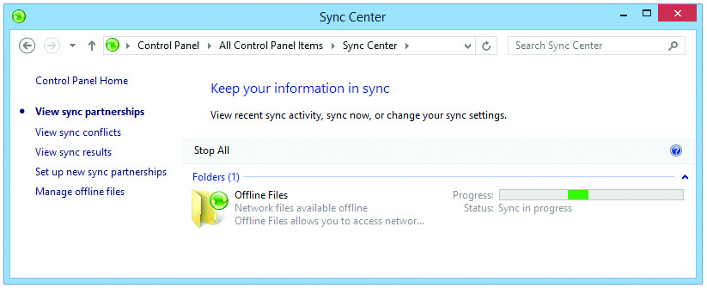
Manual Control over Power Use
Figure 24.29 Sync Center applet

Slide 69
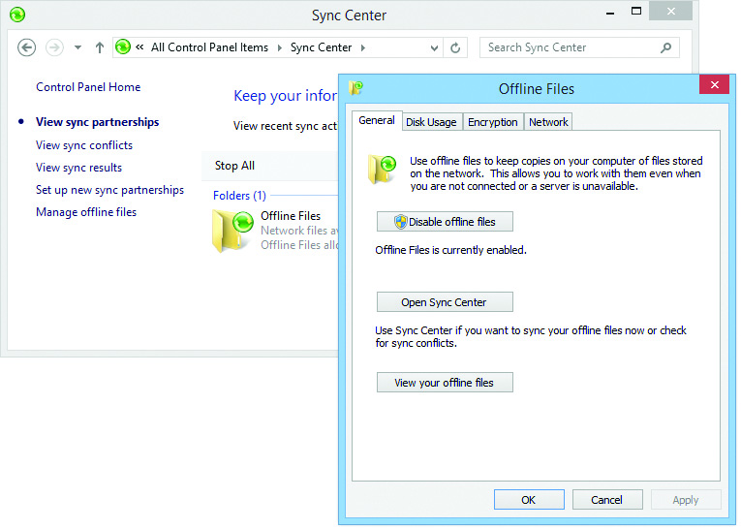
Manual Control over Power Use
Figure 24.30 Offline Files dialog box

Slide 70
Cleaning
Keep it clean.
Use a screen cleaner to clean the LCD screen.
Not a glass cleaner
Use compressed air to clean out the keyboard and PC Card sockets.
Avoid moisture on keyboard.
Notes:
70

Slide 71
Heat
Excessive heat can cause system lockups and hardware failures.
Use power management.
Keep air space between the bottom of the laptop and the surface it sits on.
Avoid using a keyboard protector for extended time periods.
Listen to your fan if your laptop has one
A fan that suddenly goes silent may have failed.
Use on a hard surface, not a lap or pillow.
Notes:
71

Slide 72
Protecting the Machine
Best practices to protect your investment
Tripping
Power cord could create a trip hazard.
Knocking a laptop off a desk is a common cause of failure.
Storage
Protect from damage, dust, and pet hair by using a case.
Remove the battery for long-term storage.

Slide 73
Protecting the Machine
Travel
Use a padded case.
Have some battery power available to avoid problems with airport security.
Keep portable in sight to prevent theft.
Remember international power is 230 V.
Know whether your portable has an auto switching power supply or a fixed input power supply.

Slide 74
Protecting the Machine
Shipping
Remove removable devices.
Don’t label or identify the box as a “new laptop computer.”
Security
Protect from theft using a laptop lock.
Use software tracking programs in case of theft.

Slide 75
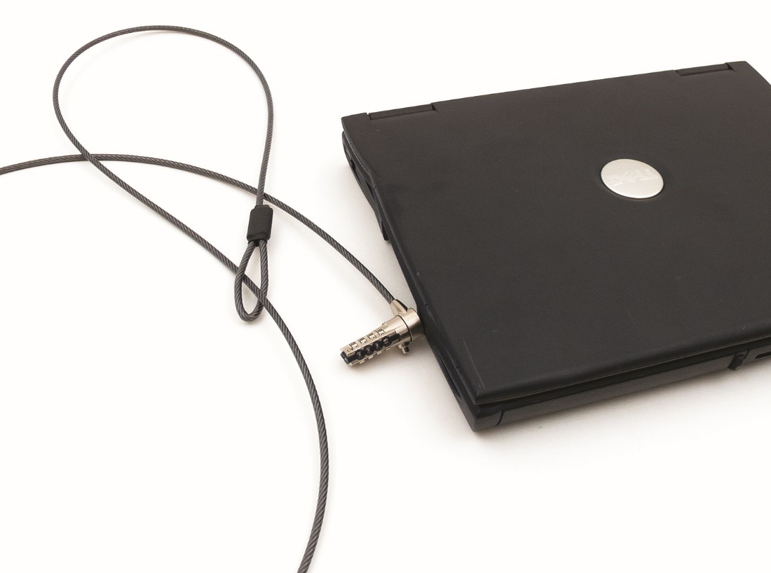
Protecting the Machine
24.31 Cable lock

Slide 76
Upgrading and Repairing Laptop Computers
Follow a four-step disassembly process.
Document and label every cable and screw location.
Organize any parts you extract from the laptop.
Refer to the manufacturer’s documentation.
Use appropriate hand tools.
Many manufacturers limit resource access unless you are an authorized repair center.
Refer client to a dedicated laptop tech.
Use YouTube and iFixit.com as resources.

Slide 77
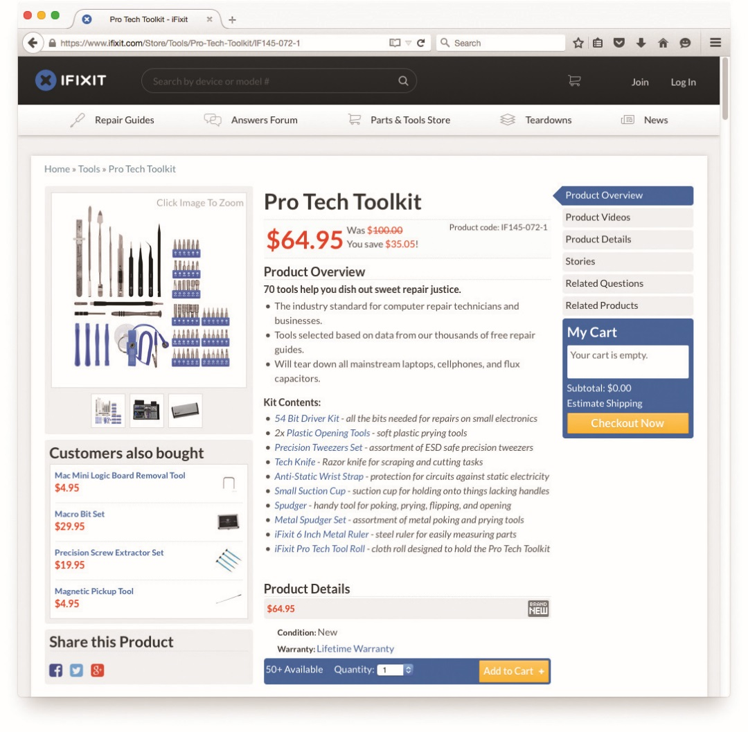
Upgrading and Repairing Laptop Computers
Figure 24.32 Bare-minimum laptop repair tools

Slide 78
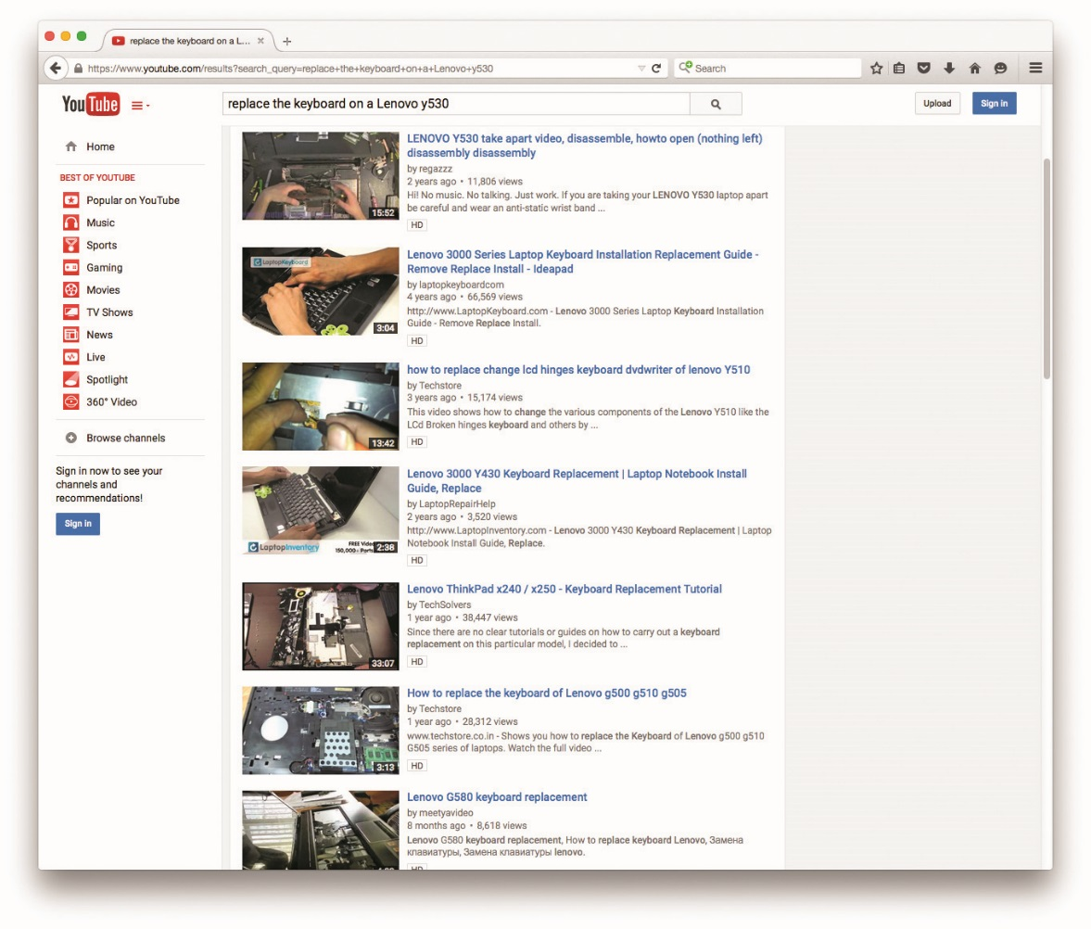
Upgrading and Repairing Laptop Computers
Figure 24.33 YouTube search result

Slide 79
Standard Upgrades
Adding RAM
Stock factory portable PCs almost always come with a minimal amount of RAM.
One of the first laptop upgrades you’ll be called on to do is to add more RAM
Most laptops have upgradeable RAM slots.
Older laptops use 144-pin SO-DIMMs with SDRAM technology or 200-pin DDR and DDR2 SO-DIMMs.
DDR3 systems primarily use 204-pin.
DDR4 SO-DIMM systems use 260-pin.

Slide 80
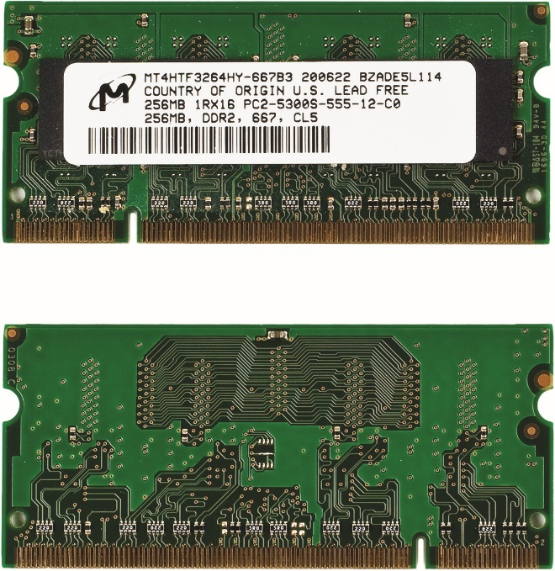
Standard Upgrades
Figure 24.35 200-pin SO-DIMM stick (front and back)

Slide 81
Standard Upgrades
Obtain the correct RAM.
Refer to manufacturer’s Web site.
Always remove electrical power first!
There is no standard location for RAM placement in portables.
Unscrew or pop open a panel on the underside.
Press out on the restraining clips and the RAM stick pops up.
Gently remove the old stick of RAM, and insert the new one by reversing the steps.
Notes:
Always remove all electrical power from the laptop before removing or inserting memory. Disconnect the AC cord from the wall outlet. Take out the battery! Failure to disconnect from power can result in a fried laptop.

Slide 82
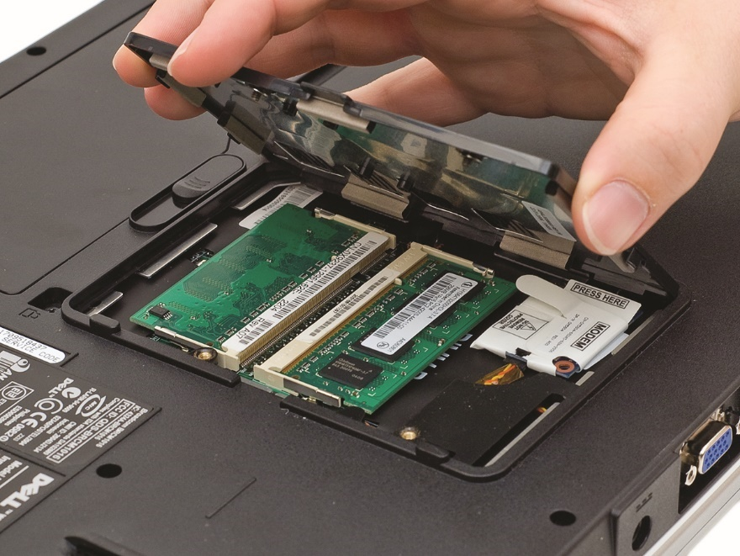
Standard Upgrades
Figure 24.36 Removing a RAM panel

Slide 83
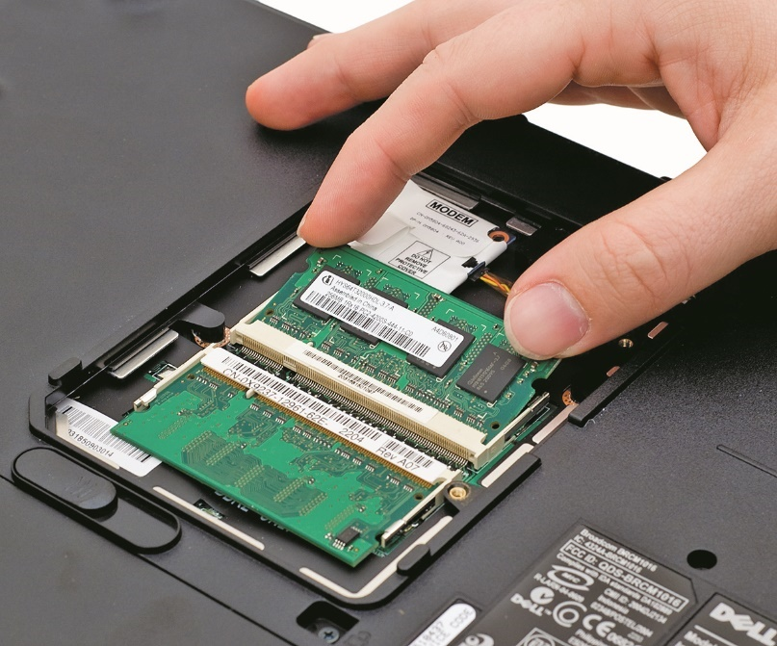
Standard Upgrades
Figure 24.37 Releasing the RAM

Slide 84
Standard Upgrades
Shared memory reduces cost of video cards.
Reduces the amount of memory on the video card itself
Adding more system RAM to a laptop with shared memory improves laptop performance.
The OS and CPU get more usable RAM.

Slide 85
Standard Upgrades
Upgrading mass storage
You can replace a hard disk drive (HDD), solid-state drive (SSD), or solid-state hybrid drive (SSHD) in a newer portable PC fairly easily.
SATA drives in the 2.5-inch format are now the standard .
An older laptop might have a PATA drive.
May need to pay more attention to cabling and jumpers.
One of the best upgrades you can make on a laptop is to go from an HDD to an SSD.

Slide 86
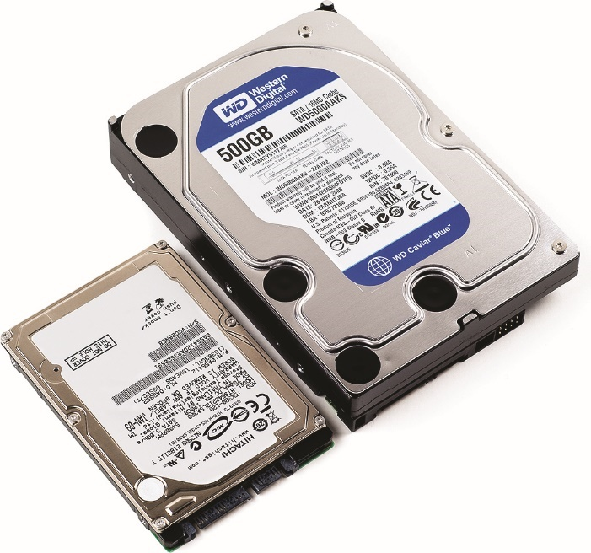
Standard Upgrades
Figure 24.38 The 2.5-inch and 3.5-inch drives are mostly the same.

Slide 87
Standard Upgrades
Hard drive replacement process
Find the hard drive hatch—either along one edge or in a compartment on the underside of the computer—and release the screws.
Remove the old drive and slide the new drive into place.
Reattach the hatch or cover and boot the computer.
Get a Windows DVD or bootable USB flash drive and prepare to reinstall.

Slide 88
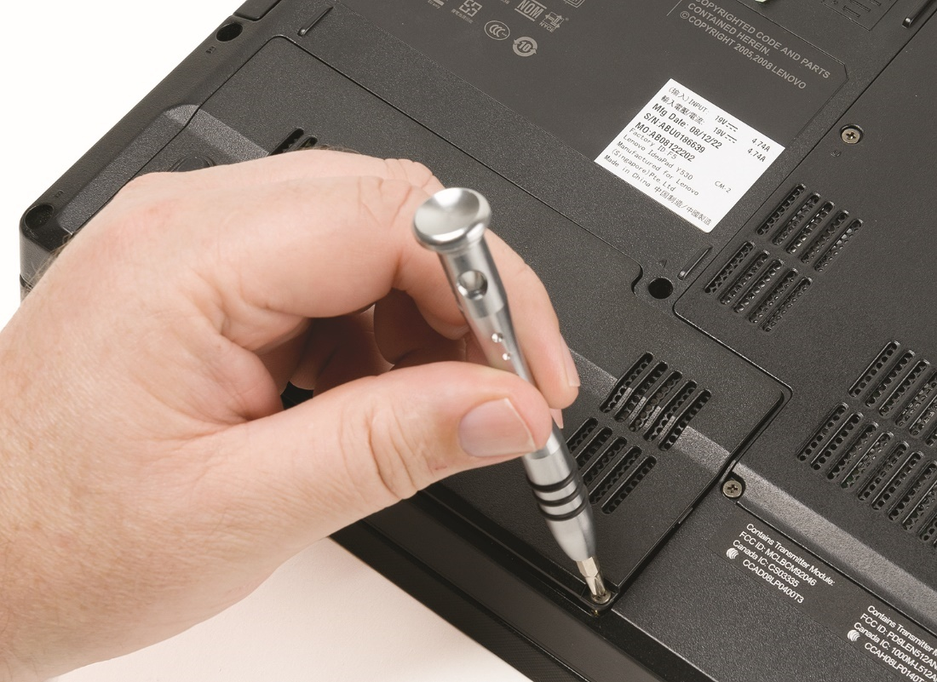
Standard Upgrades
Figure 24.39 Removing the drive compartment cover

Slide 89
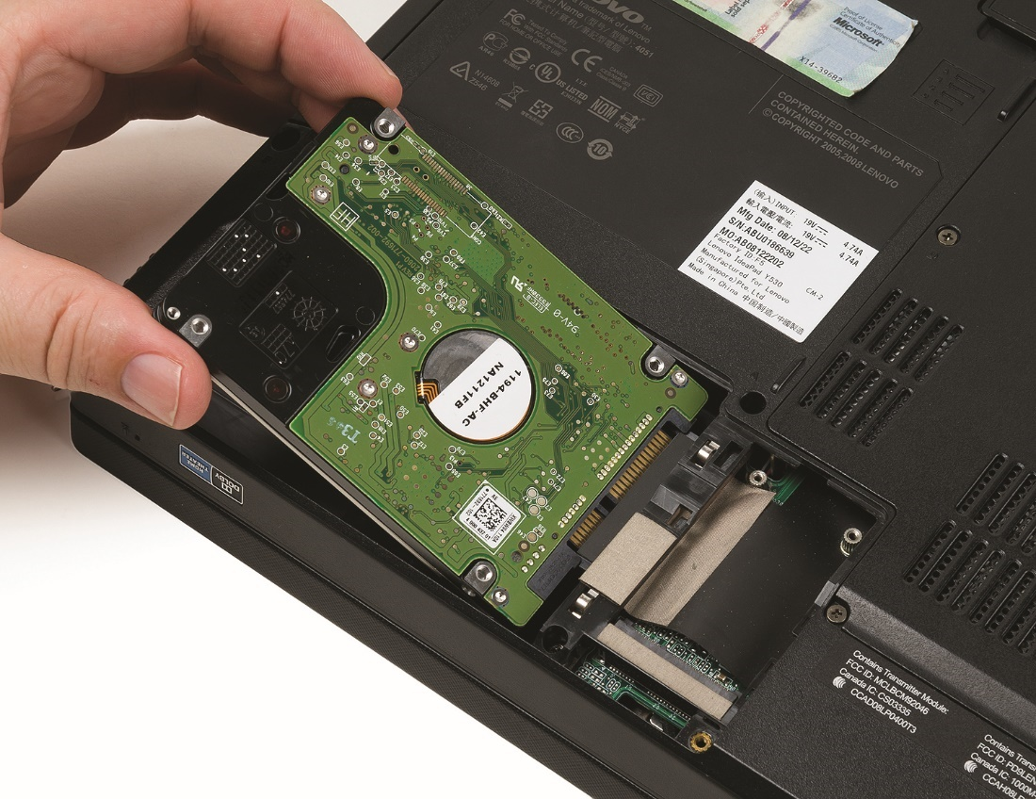
Standard Upgrades
Figure 24.40 Inserting a replacement drive

Slide 90
Hardware Replacement
Procedure for replacing some components
Detach the ribbon cable, and then reverse the steps with the replacement part.
Systems are trending toward more integrated parts.
Replaceable components may include:
Battery, keyboard, optical drive, internal speaker(s), frame, expansion cards, and CPU

Slide 91
Hardware Replacement
Battery
Replace a battery with one from the manufacturer or an aftermarket vendor.
This is usually a simple swap replacement.
Problem might not be the battery but an inadequate or malfunctioning charging system.
Keyboard
Removing often requires little pry bars, but also look for screws or clips
Keyboard connects via a tiny, short, and very delicate cable, often held down by tape.

Slide 92
Hardware Replacement
Optical drive
If system is modular, just remove the old drive and replace with a new one.
Drive might be part of the internal chassis of the portable; this would require a full dissection.

Slide 93
Hardware Replacement
Speaker
Replacing internal speakers can be simple or difficult, depending on where the speakers connect.
Speakers mounted on the outside of the chassis requires prying off the covers, pulling out the speakers, disconnecting the cable, and reversing the process to install the replacement speakers.
Speakers mounted inside the chassis require dismantling the portable to get to them.

Slide 94
Hardware Replacement
Frame
Comprised of plastic, metal, or rubber parts
Locate a suitable replacement part
Expansion cards
Many portable PCs have one or more true expansion slots for add-on cards.
The more modular varieties will have a hatch on the bottom of the case that opens to give you access to the slot(s).
Avoid ESD and remove all electricity before you take out or put in an expansion card.

Slide 95
Hardware Replacement
Wireless cards
Connect the card to the slot properly; reattach the antenna connection and often a separate power cable.
When removing the card, pay attention to the placement of these vital connections.
Two types of expansion slots
Mini-PCIe
M.2 – Formerly Next Generation Form Factor (NGFF)

Slide 96
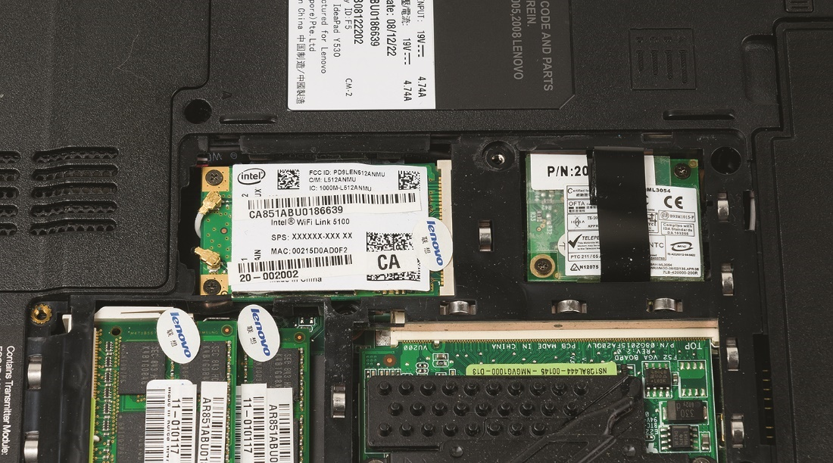
Hardware Replacement
Figure 24.41 Mini-PCIe expansion slot on laptop

Slide 97
Hardware Replacement
CPU
Many CPUs mount facing the bottom of the portable, so that it vents away from your hands.
When sitting properly on a flat surface, heated air goes toward the back of the laptop rather than toward the user.
Access this type of CPU from the bottom.
Elaborate heat-sink and fan assembly includes both CPU and chipset.
Each of the pieces screws down in multiple places and the fan has a power connection.

Slide 98
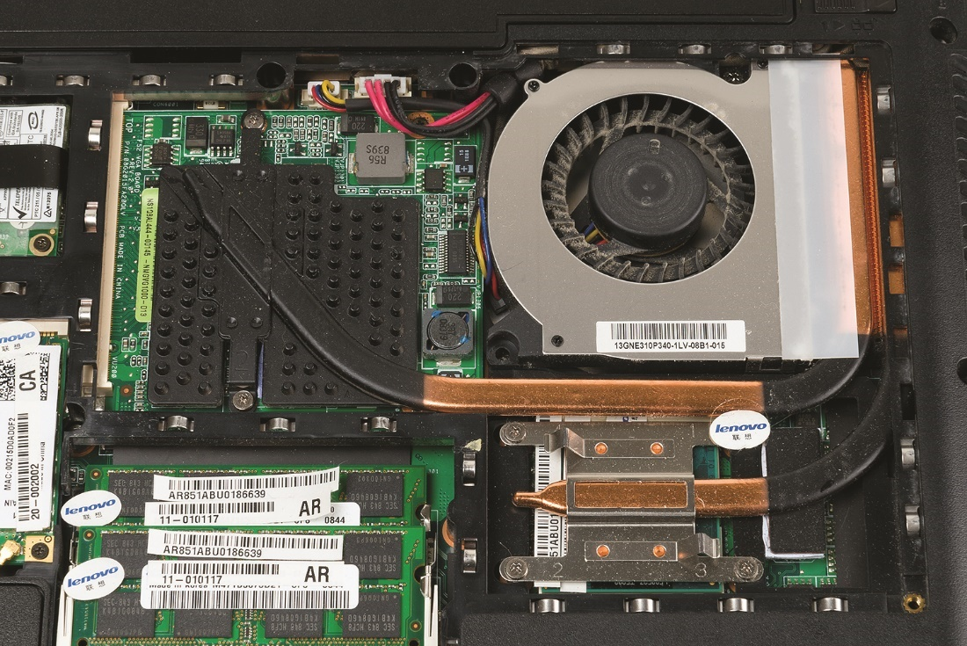
Hardware Replacement
Figure 24.42 CPU heat-sink and fan assembly exposed

Slide 99
Hardware Replacement
CPU replacement process
Remove all power from the laptop, including the battery.
Remove the hatch to expose the CPU.
Remove the heat-sink and fan assembly and lift out the CPU.
Replace it with another CPU, apply thermal paste, and reattach the heat-sink and fan assembly.
Reconnect the fan power connector.

Slide 100
Hardware Replacement
Integral parts
Some components require a complete teardown of the system.
Screen, DC jack, touchpad, and system board
Portables open in two different ways, depending on the manufacturer.
Peel away layers from the top down, through the keyboard, or from the bottom up, through the base. Either direction requires careful attention to detail, part connectivity, and locations.
You’ll need a system to keep track of the dozens of tiny screws.

Slide 101
Hardware Replacement
Detach the screen from the main chassis of the portable.
Pay attention to the connection points for the data stream to the monitor and the antenna in the frame of the display.
Once you have the portable stripped down, replace defunct component and then begin building it back up.
Pay incredibly careful attention to getting data cables reconnected properly as you rebuild.

Slide 102
Troubleshooting Portable Computers
Many of the troubleshooting techniques for desktop systems can be applied to laptops.
Take the proper precautions before and during disassembly.
Use the proper hand tools.
Document, label, and organize each plastic part and screw location for reassembly.
Some laptop-specific procedures apply.

Slide 103
Power and Performance
Laptop won’t power on.
Verify the outlet is good.
Verify the AC adapter is good.
Remove all peripherals.
You notice poor performance.
Check Task Manager (Windows) or Activity Monitor (Mac OS X).
Perform a hard reboot.
Hold power button down for ten seconds.

Slide 104
Power and Performance
Battery issues
Swollen battery symptoms include:
A laptop that doesn’t sit right on hard surfaces
A screen that doesn’t sit flush when closed
Problems with input devices or visibly deformed case
The cause of a swollen battery is overcharging.
Check AC adapter or replace with known good battery if battery is not charging.

Slide 105
Power and Performance
Overheating
Be alert to any device that is hot to the touch.
Power the device down and remove the battery to cool.
Know when to expect a hot device.
When system is busy or charging

Slide 106
Components
Display problems
Make sure the display is turned on.
Press the FN key and the key to activate the screen.
Check the LCD cutoff switch.
If laptop display is dim, you may have lost an inverter.
Usually makes loud hum and popping noise when the inverter fails

Slide 107
Components
Display problems
If a display won’t come on, try an external monitor.
With a flickering display, crank up the brightness or replace the laptop.
If screen orientation doesn’t change when rotated, auto-rotation may be disabled.

Slide 108
Components
Problems with wireless devices (Bluetooth, Wi-Fi, Mobile Broadband, NFC, or GPS)
Check the physical switch that toggles the internal wireless adapter.
Also check notification area for airplane icon.
Dead wireless could mean disconnected antenna if tech has recently removed laptop display.
Try special key combination to toggle wireless or Bluetooth adapter, or airplane mode.

Slide 109
Components
Problems with wireless devices
You might be out of range or at the edge of range.
Remember the Bluetooth pairing process requires action on both devices to succeed.
If only GPS is not functioning, check the Location Settings applet in Control Panel or Privacy section of the Settings app to see if it is enabled.

Slide 110
Components
Audio problems
Check for hardware mute or volume button or switch
Verify application is using the right output device
Ensure speakers are properly connected
If headphones or external speakers work fine, internal speakers may be damaged

Slide 111
Components
Input problems
Confirm the system is otherwise running smoothly.
If none of the keys work, there’s a good chance you’ve unseated the keypad connector.
Check the manufacturer’s disassembly procedures to locate and reseat the keypad.
If you’re getting numbers when you’re expecting to get letters, the number lock (NUMLOCK) function key is turned on.
Turn it off.

Slide 112
Components
Input problems
For problems with sticking keys, look for obvious debris.
Used compressed air to clean.
If you have serious goo and need to use a cleaning solution, disconnect the keyboard from the portable first.
Make sure it is completely dry before you reconnect it or you’ll short it out.

Slide 113
Components
Input problems
A switch might be knocked out of place if the key is slightly raised or tilted.
If the touchpad is having problems, a shot of compressed air can help clean it out.
May be registering an unintentional touch if hand or arm is located too close to the touchscreen.

Slide 114
Components
Check touchscreen diagnostics in hardware troubleshooting menus accessible through the BIOS.
Refer to manufacturer’s resources for instructions to access.
Tablet PC Settings applet in Control Panel enables recalibration or reset of touch support.

Slide 115


Slide 116
Summary
Describe the many types of portable computing devices available
Explain ways to expand portable computers
Manage and maintain portable computers
Upgrade and repair portable computers
Troubleshoot portable computers

Slide 117


